Slide 1
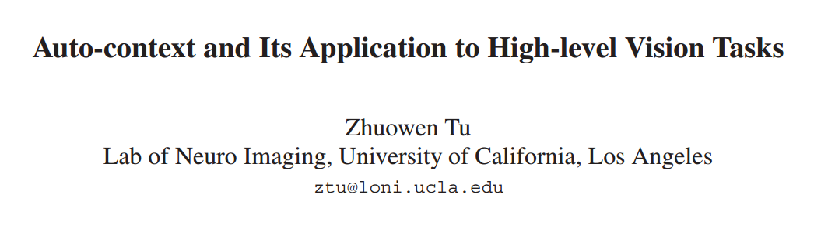

Slide 2








Task
Object segmentation, human body configuration, scene region labeling.
Objective
Image
Label
Training set
Bayes rule
MAP
Modeling
Problem
Computing
The combination of the p(X|Y) and p(Y) is often non-regular.
Solution Marginal distribution (1)
Motivation
Combine appearance and context information

Slide 3


Traditional approaches
Classification
Limitation: This is a very crude approximation to eqn. (1) and it only uses some context implicitly through image patch X(N)
Existing methods: Conditional Random Field (CRF), Discriminative Markov Random Fields (DRFs)
1) Fixed neighborhood structure with limited number of connections
Limitation
2) Computing complexity explodes on large neighborhood structure
Proposal: Auto-context

Slide 4
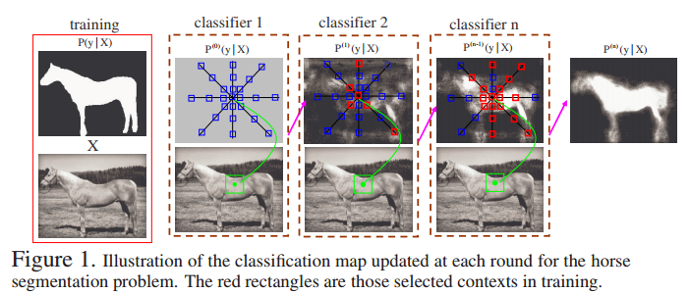
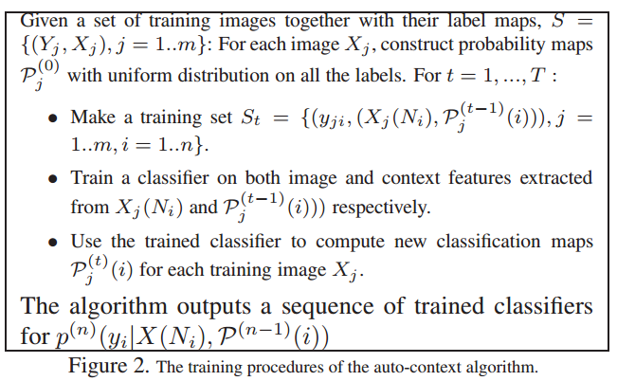


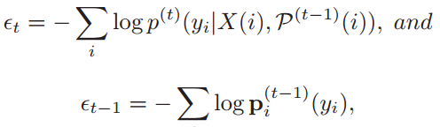

Pipeline
Proof
Non-increase
Boosting
Convergence

Slide 5
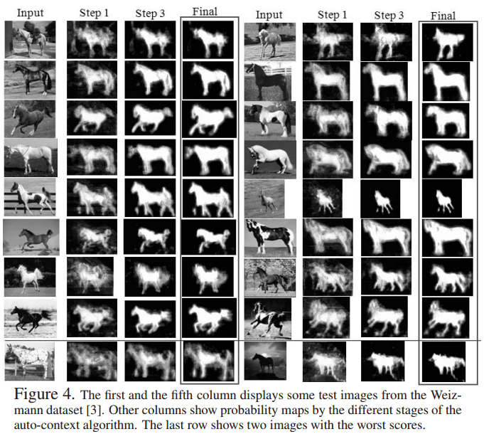
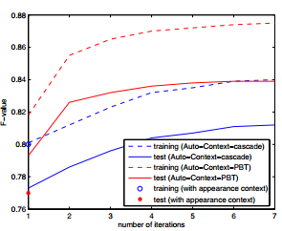
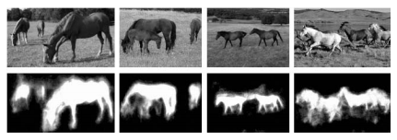
Experiments
Horse Segmentation
Feature
1) appearance (8000)
patch size 21*21
canny edge, Haar filter responses
gradients
2) context (4000)
probability
mean probability
or higher order ones

Slide 6
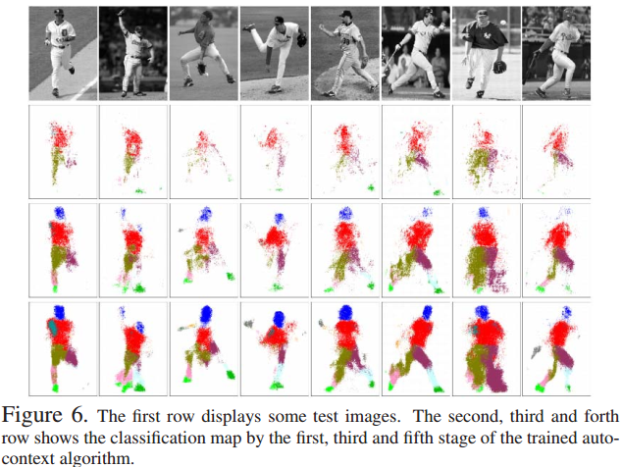
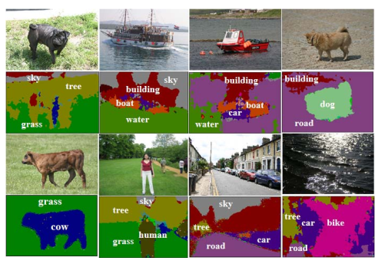
Experiments
Human body configuration
Scene parsing

Slide 7
Thank you!

